Slide 1
UNIT 2
JAVASCRIPT

Slide 2
REFERENCE MATERIAL
Robert W. Sebesta (2015), Programming The World Wide Web, Eighth Edition, Pearson
Chapter 4

Slide 3
INTRODUCTION

Slide 4
JavaScript Components
Core
The heart of the language
Client-side
Library of objects supporting browser control and user interaction
Server-side
Library of objects that support use in web servers
Text focuses on Client-side

Slide 5
Java and JavaScript
Differences
JavaScript has a different object model from Java
JavaScript is not strongly typed
Java 1.6 has support for scripting
http://java.sun.com/javase/6/docs/technotes/guides/scripting/index.html
Mozilla Rhino is an implementation of JavaScript in Java
http://www.mozilla.org/rhino/

Slide 6
Uses of JavaScript
Provide alternative to server-side programming
Servers are often overloaded
Client processing has quicker reaction time
JavaScript can work with forms
JavaScript can interact with the internal model of the web page (Document Object Model)
JavaScript is used to provide more complex user interface than plain forms with HTML/CSS can provide
http://www.protopage.com/ is an interesting example
A number of toolkits are available. Dojo, found at http://dojotoolkit.org/, is one example

Slide 7
Event-Driven Computation
Users actions, such as mouse clicks and key presses, are referred to as events
The main task of most JavaScript programs is to respond to events
For example, a JavaScript program could validate data in a form before it is submitted to a server
Caution: It is important that crucial validation be done by the server. It is relatively easy to bypass client-side controls
For example, a user might create a copy of a web page but remove all the validation code.

Slide 8
JavaScript in XHTML**
Directly embedded
<script type=“text/javascript”>
<!--
…Javascript here…
-->
</script>
However, note that a-- will not be allowed here!
Indirect reference
<script type=“text/javascript” src=“tst_number.js”/>
This is the preferred approach

Slide 9
General Syntactic Characteristics
Identifiers
Start with $, _, letter
Continue with $, _, letter or digit
Case sensitive
Reserved words
Comments
//
/* … */

Slide 10
Statement Syntax**
Statements can be terminated with a semicolon
However, the interpreter will insert the semicolon if missing at the end of a line and the statement seems to be complete
Can be a problem:
return
x;
If a statement must be continued to a new line, make sure that the first line does not make a complete statement by itself

Slide 11
Primitive Types**
Five primitive types
Number
String
Boolean
Undefined
Null
There are five classes corresponding to the five primitive types
Wrapper objects for primitive values
Place for methods and properties relevant to the primitive types
Primitive values are coerced to the wrapper class as necessary, and vice-versa

Slide 12
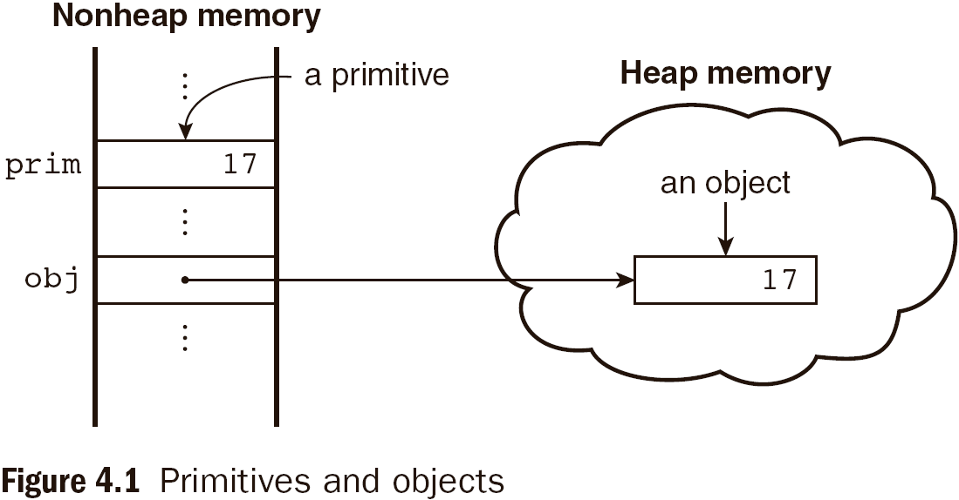
Object Sto Object Storage
Primitive and Object Storage

Slide 13
Numeric and String Literals
Number values are represented internally as double-precision floating-point values
Number literals can be either integer or float
Float values may have a decimal and/or and exponent
A String literal is delimited by either single or double quotes
There is no difference between single and double quotes
Certain characters may be escaped in strings
\’ or \” to use a quote in a string delimited by the same quotes
\\ to use a literal backspace
The empty string ‘’ or “” has no characters

Slide 14
Other Primitive Types
Null
A single value, null
null is a reserved word
A variable that is used but has not been declared nor been assigned a value has a null value
Using a null value usually causes an error
Undefined
A single value, undefined
However, undefined is not, itself, a reserved word
The value of a variable that is declared but not assigned a value
Boolean
Two values: true and false

Slide 15
Declaring Variables**
JavaScript is dynamically typed, that is, variables do not have declared types
A variable can hold different types of values at different times during program execution
A variable is declared using the keyword var
var counter,
index,
pi = 3.14159265,
quarterback = "Elway",
stop_flag = true;

Slide 16
Numeric Operators
Standard arithmetic
+ * - / %
Increment and decrement
-- ++
Increment and decrement differ in effect when used before and after a variable
Assume that a has the value 7, initially
(++a) * 3 has the value 24
(a++) * 3 has the value 27
a has the final value 8 in either case

Slide 17
Precedence of Operators
Operators | Associativity
++, --, unary - | Right
*, /, % | Left
+, - | Left
>, <, >= ,<= | Left
==, != | Left
===,!== | Left
&& | Left
|| | Left
=, +=, -=, *=, /=, &=, |=, %= | Right

Slide 18
String CONCatenation**
The operation + is the string concatenation operation
In many cases, other types are automatically converted to string

Slide 19
Implicit Type Conversion**
JavaScript attempts to convert values in order to be able to perform operations
“August “ + 1977 causes the number to be converted to string and a concatenation to be performed
7 * “3” causes the string to be converted to a number and a multiplication to be performed
null is converted to 0 in a numeric context, undefined to NaN
0 is interpreted as a Boolean false, all other numbers are interpreted a true
The empty string is interpreted as a Boolean false, all other strings (including “0”!) as Boolean true
undefined, Nan and null are all interpreted as Boolean false

Slide 20
Explicit Type Conversion**
Explicit conversion of string to number
Number(aString)
aString – 0
Number must begin the string and be followed by space or end of string
parseInt and parseFloat convert the beginning of a string but do not cause an error if a non-space follows the numeric part

Slide 21
The typeof Operator**
Returns “number” or “string” or “boolean” for primitive types
Returns “object” for an object or null
Two syntactic forms
typeof x
typeof(x)

Slide 22
Assignment Statements
Plain assignment indicated by =
Compound assignment with
+= -= /= *= %= …
a += 7 means the same as
a = a + 7

Slide 23
Control Statements
A compound statement in JavaScript is a sequence of 0 or more statements enclosed in curly braces
Compound statements can be used as components of control statements allowing multiple statements to be used where, syntactically, a single statement is specified
A control construct is a control statement including the statements or compound statements that it contains

Slide 24
Control Expressions
A control expression has a Boolean value
An expression with a non-Boolean value used in a control statement will have its value converted to Boolean automatically
Comparison operators
== != < <= > >=
=== compares identity of values or objects
3 == ‘3’ is true due to automatic conversion
3 === ‘3’ is false
Boolean operators
&& || !
Warning! A Boolean object evaluates as true
Unless the object is null or undefined

Slide 25
Selection Statements
The if-then and if-then-else are similar to that in other programming languages, especially C/C++/Java

Slide 26
switch Statement Syntax
switch (expression) {
case value_1:
// statement(s)
case value_2:
// statement(s)
...
[default:
// statement(s)]
}

Slide 27
switch Statement Semantics
The expression is evaluated
The value of the expressions is compared to the value in each case in turn
If no case matches, execution begins at the default case
Otherwise, execution continues with the statement following the case
Execution continues until either the end of the switch is encountered or a break statement is executed

Slide 28
Loop Statements
Loop statements in JavaScript are similar to those in C/C++/Java
While
while (control expression)
statement or compound statement
For
for (initial expression; control expression; increment expression)
statement or compound statement
do/while
do statement or compound statement
while (control expression)

Slide 29
while Statement Semantics
The control expression is evaluated
If the control expression is true, then the statement is executed
These two steps are repeated until the control expression becomes false
At that point the while statement is finished

Slide 30
for Statement Semantics
The initial expression is evaluated
The control expression is evaluated
If the control expression is true, the statement is executed
Then the increment expression is evaluated
The previous three steps are repeated as long as the control expression remains true
When the control expression becomes false, the statement is finished executing

Slide 31
do/while Statement Semantics
The statement is executed
The control expression is evaluated
If the control expression is true, the previous steps are repeated
This continues until the control expression becomes false
At that point, the statement execution is finished

